Slide 1
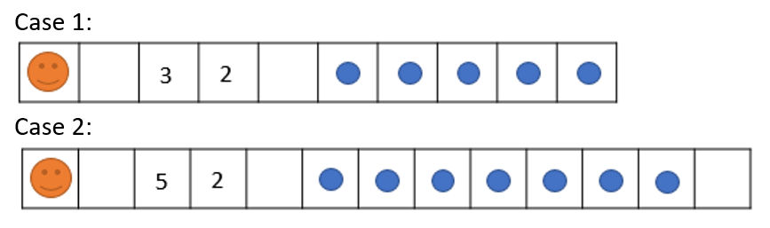
GO RIGHT
GO RIGHT
SET <MY-NUMBER> TO <VALUE ON CELL>
GO RIGHT
INCREMENT <MY-NUMBER> OF <VALUE ON CELL>
GO RIGHT
REPEAT <MY-NUMBER>
DRAW THE FLOWCHART
GO RIGHT
PAINT-CELL

Slide 2
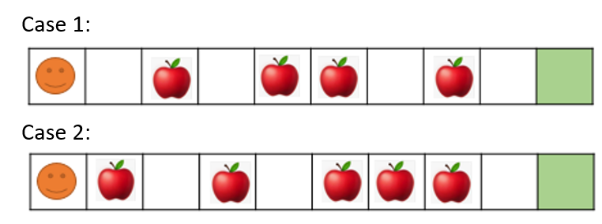
SET <MY-NUMBER> TO <0>
WHILE <HAS-CELL ON RIGHT>
GO RIGHT
IF <HAS APPLE>
PICK UP
INCREMENT <MY-NUMBER> OF <1>
DRAW THE FLOWCHART
WRITE <MY-NUMBER>

Slide 3
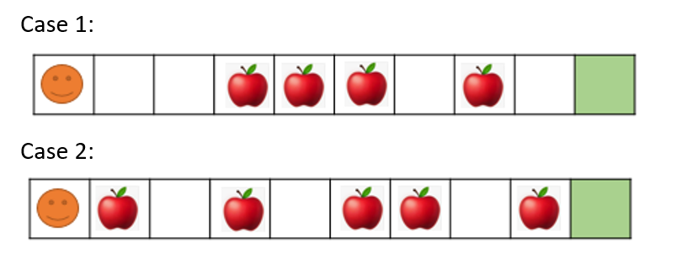
SET <MY-NUMBER> TO <0>
WHILE <HAS-CELL ON RIGHT>
IF <HAS APPLE>
PICK UP
INCREMENT <MY-NUMBER> OF <1>
ELSE
PAINT-CELL
DRAW THE FLOWCHART
GO RIGHT
WRITE <MY-NUMBER>

Slide 4
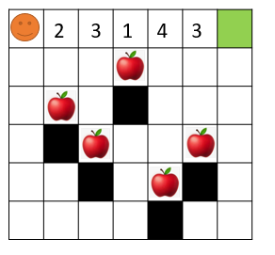
REPEAT <5> TIMES
GO RIGHT
SET <MY-NUMBER> TO <VALUE ON CELL>
REPEAT <MY-NUMBER> TIMES
GO DOWN
PICK UP
GO DOWN
DRAW THE FLOWCHART
DROP
REPEAT <MY-NUMBER + 1> TIMES
GO UP

Slide 5
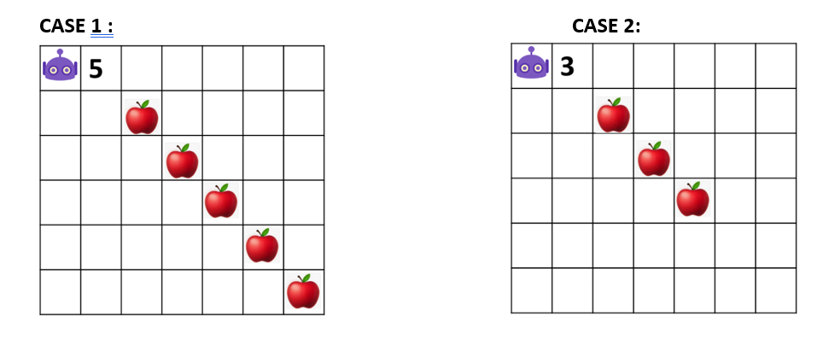
GO RIGHT
SET <MY-NUMBER> TO <VALUE ON CELL>
REPEAT <MY-NUMBER> TIMES
GO RIGHT
GO DOWN
PICK UP
DRAW THE FLOWCHART

Slide 6
DRAW THE FLOWCHART AND DEFINE THE OUTPUT
SET <MY-NUMBER> TO <0>
WHILE MY-NUMBER < 5
INCREMENT <MY-NUMBER> OF <1>
WRITE MY-NUMBER

Slide 7
DRAW THE FLOWCHART AND DEFINE THE OUTPUT
SET <MY-NUMBER> TO <0>
WHILE MY-NUMBER < 5
INCREMENT <MY-NUMBER> OF <1>
WRITE MY-NUMBER

Slide 8
DRAW THE FLOWCHART AND DEFINE THE OUTPUT
SET <MY-NUMBER> TO <0>
WHILE MY-NUMBER < 5
INCREMENT <MY-NUMBER> OF <3>
WRITE MY-NUMBER

Slide 9
DRAW THE FLOWCHART AND DEFINE THE OUTPUT
SET <MY-NUMBER> TO <0>
WHILE MY-NUMBER < 5
INCREMENT <MY-NUMBER> OF <3>
WHILE MY-NUMBER < 10
INCREMENT <MY-NUMBER> OF <3>
WRITE MY-NUMBER

Slide 10
DRAW THE FLOWCHART AND DEFINE THE OUTPUT
SET <MY-NUMBER> TO <0>
WHILE MY-NUMBER < 5
INCREMENT <MY-NUMBER> OF <3>
WHILE MY-NUMBER < 10
INCREMENT <MY-NUMBER> OF <3>
WHILE MY-NUMBER < 15
INCREMENT <MY-NUMBER> OF <3>
WRITE MY-NUMBER

Slide 11
DRAW THE FLOWCHART AND DEFINE THE OUTPUT
WHILE MY-NUMBER < 5
SET <MY-NUMBER> TO <0>
INCREMENT <MY-NUMBER> OF <3>
WHILE MY-NUMBER < 10
INCREMENT <MY-NUMBER> OF <3>
WHILE MY-NUMBER < 15
INCREMENT <MY-NUMBER> OF <3>
WRITE MY-NUMBER

Slide 12
DRAW THE FLOWCHART AND DEFINE THE OUTPUT
SET <MY-NUMBER> TO <0>
WHILE MY-NUMBER < 5
INCREMENT <MY-NUMBER> OF <3>
IF MY-NUMBER < 10
INCREMENT <MY-NUMBER> OF <3>
IF MY-NUMBER < 15
INCREMENT <MY-NUMBER> OF <3>
WRITE MY-NUMBER

Slide 13
DRAW THE FLOWCHART AND DEFINE THE OUTPUT
SET <MY-NUMBER> TO <0>
WHILE MY-NUMBER < 5
INCREMENT <MY-NUMBER> OF <3>
REPEAT <MY-NUMBER>
INCREMENT <MY-NUMBER> OF <5>
IF MY-NUMBER < 15
INCREMENT <MY-NUMBER> OF <3>
WRITE MY-NUMBER

Slide 14
DRAW THE FLOWCHART AND DEFINE THE OUTPUT
SET <MY-NUMBER> TO <0>
WHILE MY-NUMBER < 5
INCREMENT <MY-NUMBER> OF <3>
IF MY-NUMBER > 3
INCREMENT <MY-NUMBER> OF <5>
ELSE
INCREMENT <MY-NUMBER> OF <10>
WRITE MY-NUMBER

Slide 15
DRAW THE FLOWCHART AND DEFINE THE OUTPUT
SET <MY-NUMBER> TO <0>
WHILE MY-NUMBER < 5
SET <SUM> TO <0>
INCREMENT <SUM> OF <2>
INCREMENT <MY-NUMBER> OF <3>
IF SUM > 3
INCREMENT <SUM> OF <5>
ELSE
INCREMENT <SUM> OF <10>
WRITE SUM

Slide 16
DRAW THE FLOWCHART AND DEFINE THE OUTPUT
SET <MY-NUMBER> TO <0>
WHILE MY-NUMBER < 5
INCREMENT <MY-NUMBER> OF <3>
IF MY-NUMBER > 3
DECREMENT <MY-NUMBER> OF <4>
ELSE
INCREMENT <MY-NUMBER> OF <10>
WRITE MY-NUMBER

Slide 17
DRAW THE FLOWCHART AND DEFINE THE OUTPUT
SET <MY-NUMBER> TO <0>
WHILE MY-NUMBER < 5
SET <MY-NUMBER> TO <0>
INCREMENT <MY-NUMBER> OF <3>
IF MY-NUMBER > 3
DECREMENT <MY-NUMBER> OF <4>
ELSE
INCREMENT <MY-NUMBER> OF <10>
WRITE MY-NUMBER

Slide 18
SET <MY-NUMBER> TO <0>
DRAW THE FLOWCHART AND DEFINE THE OUTPUT
WHILE MY-NUMBER < 5
REPEAT 3
INCREMENT <MY-NUMBER> OF <4>
REPEAT 2
INCREMENT <MY-NUMBER> OF <2>
REPEAT 1
INCREMENT <MY-NUMBER> OF <1>
WRITE MY-NUMBER

Slide 19
SET <MY-NUMBER> TO <0>
DRAW THE FLOWCHART AND DEFINE THE OUTPUT
WHILE MY-NUMBER < 5
REPEAT 3
INCREMENT <MY-NUMBER> OF <4>
REPEAT 2
INCREMENT <MY-NUMBER> OF <2>
WRITE MY-NUMBER

Slide 20
SET <MY-NUMBER> TO <0>
DRAW THE FLOWCHART AND DEFINE THE OUTPUT
WHILE MY-NUMBER < 5
REPEAT 3
INCREMENT <MY-NUMBER> OF <4>
REPEAT 2
INCREMENT <MY-NUMBER> OF <2>
REPEAT 1
INCREMENT <MY-NUMBER> OF <1>
WRITE MY-NUMBER

Slide 21
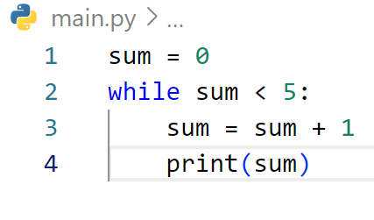
FINE THE OUTPUT

Slide 22
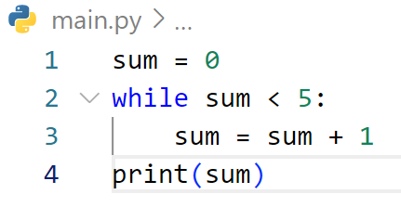
FINE THE OUTPUT

Slide 23
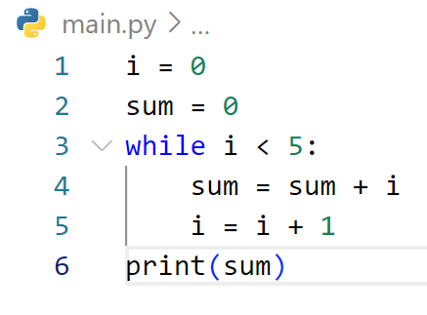
FINE THE OUTPUT

Slide 24
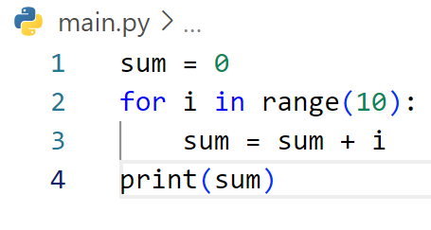
FINE THE OUTPUT

Slide 25
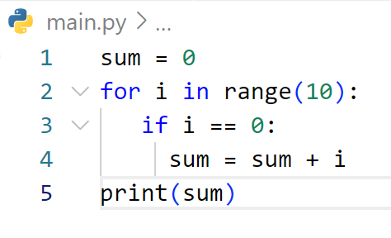
FINE THE OUTPUT

Slide 26
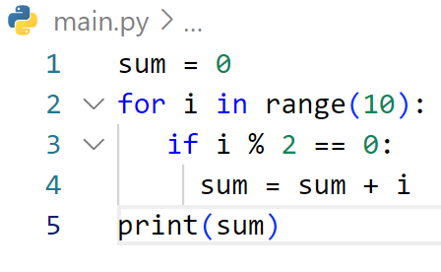
FINE THE OUTPUT

Slide 27
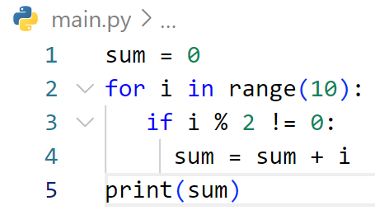
FINE THE OUTPUT

Slide 28
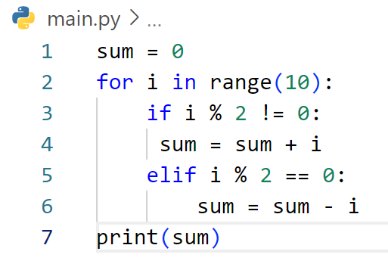
FINE THE OUTPUT

Slide 29
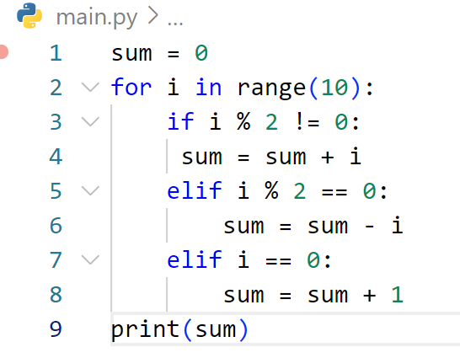
FINE THE OUTPUT

Slide 30
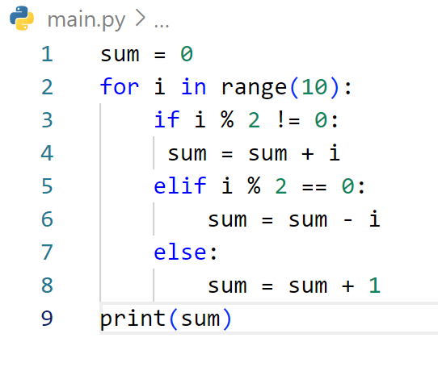
FINE THE OUTPUT

Slide 31
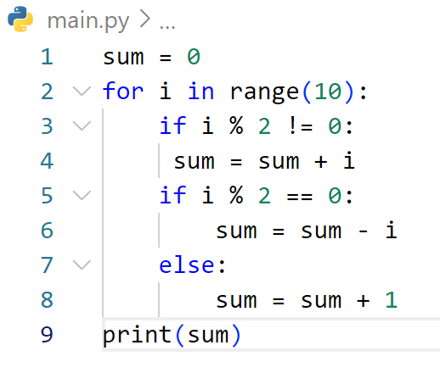
FINE THE OUTPUT

Slide 32
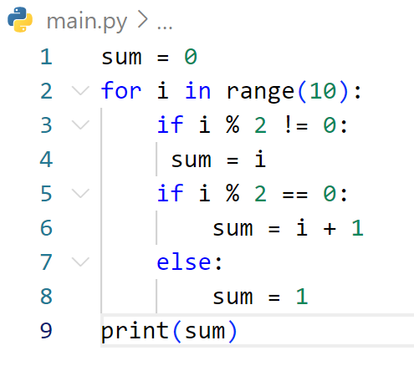
FINE THE OUTPUT

Slide 33
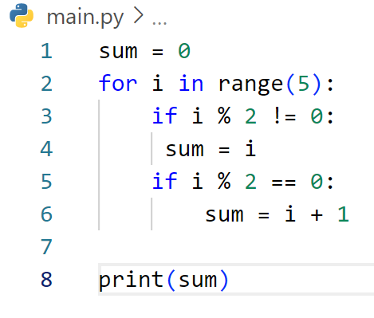
FINE THE OUTPUT

Slide 34
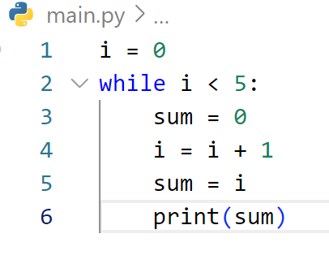
FINE THE OUTPUT

Slide 35
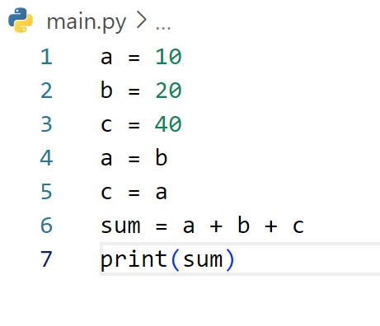
FINE THE OUTPUT

Slide 36
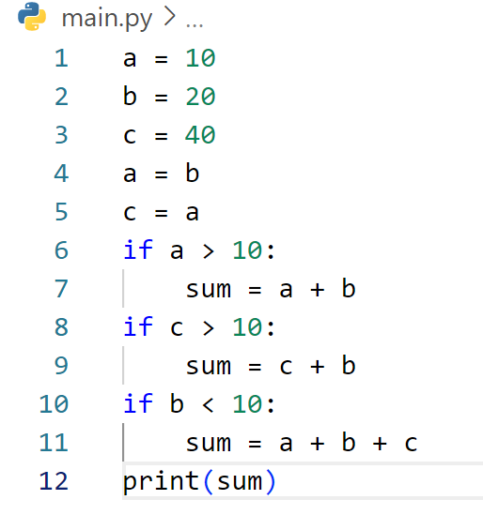
FINE THE OUTPUT

Slide 37
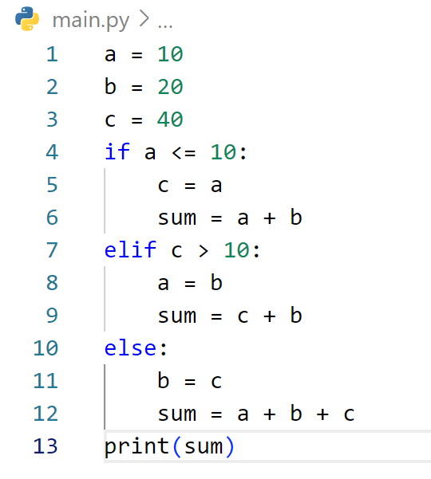
FINE THE OUTPUT

Slide 38
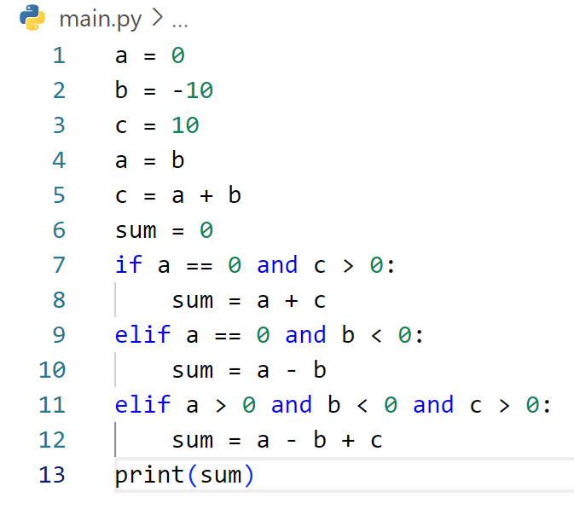
FINE THE OUTPUT

Slide 39
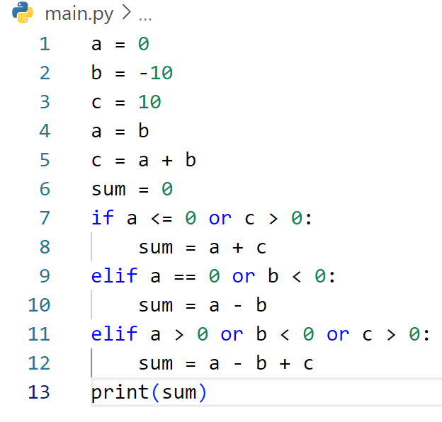
FINE THE OUTPUT

Slide 40
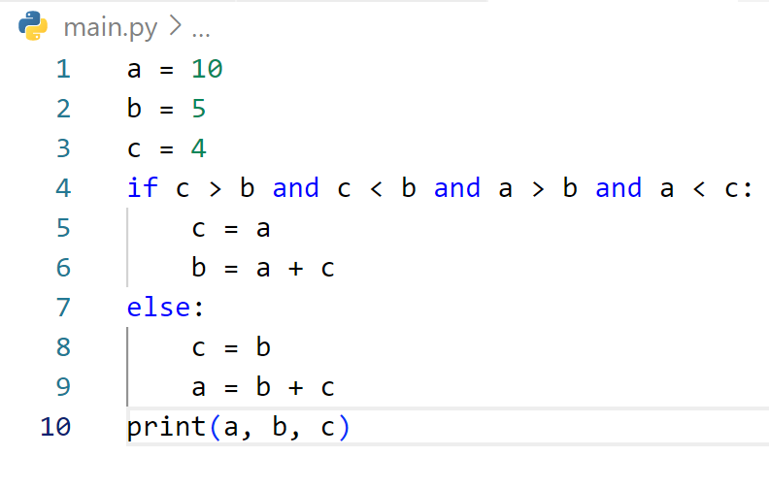
FINE THE OUTPUT

Slide 41
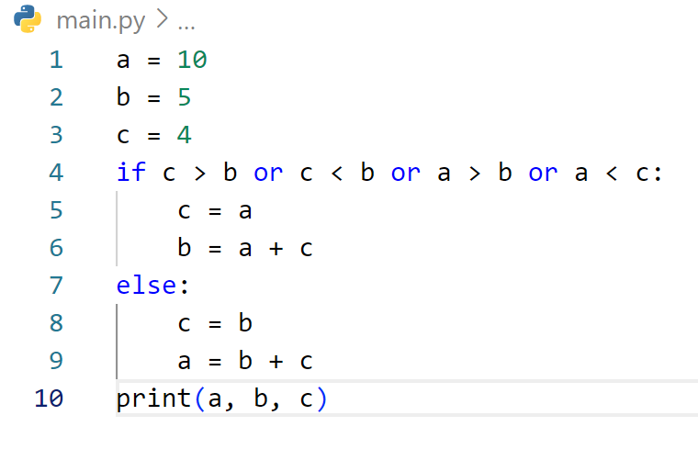
FINE THE OUTPUT

Slide 42
ចប់ដោយបរិបូរណ៍

